Slide 1
Childhoold Pneumonia Detection
Rebecca Mih

Slide 2
Pneumonia is the world’s leading infectious killer of children, claiming the lives of more than 800,000 children under the age of five every year, more than 2,000 every day.
Unicef, 2019
Notes:
This is the question that your experiment answers

Slide 3
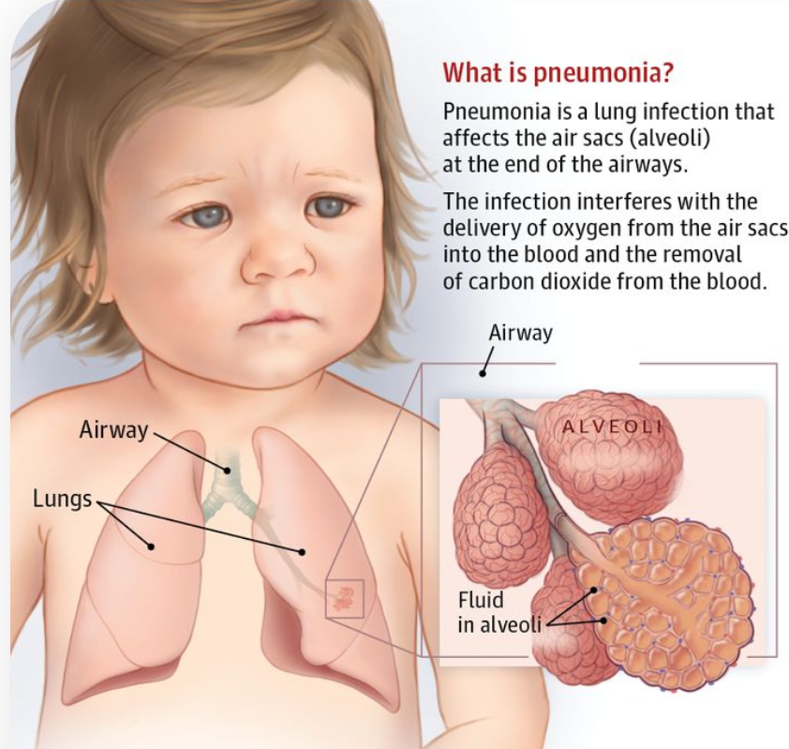
What is Pneumonia in Children
Pneumonia is an infection in the lungs, commonly the alveoli fill with fluid.
Pneumonia is most often caused by bacteria or viruses or fungi. Bacterial pneumonia must be treated timely with antibiotics
This project uses neural networks to classify whether an x-ray is of a child sick with pneumonia, or well.

Slide 4
What is Pneumonia in Children
Pneumonia is an infection in the lungs, commonly the alveoli fill with pus. It can be mild or serious. Pneumonia is generally more common in children younger than 5 years old.
What causes pneumonia in a child?
Pneumonia is most often caused by bacteria or viruses.
Include a brief overview or summary of your project

Slide 5
Research
First research point
Second research point
Third research point
Notes:
Summarize your research in three to five points.

Slide 6
Variables
Controlled variables
Independent variable
Dependent variable
These are kept the same throughout your experiments
The one variable you purposely change and test
The measure of change observed because of independent variable
Decide how you will measure the change

Slide 7
Add your answer / solution here
Hypothesis
Notes:
Establish hypothesis before you begin the experiment. This should be your best educated guess based on your research.

Slide 8
Materials
Materials (detailed list) | Quantity (be specific)
Item | Amount
Item | Amount
Item | Amount
Item | Amount
Item | Amount
Item | Amount
Item | Amount

Slide 9
Procedure
Step 1
Describe this step in your experiment
Step 2
Describe this step in your experiment
Step 3
Describe this step in your experiment
Step 4
Describe this step in your experiment
Notes:
List all of the steps used in completing your experiment.
Remember to number your steps.

Slide 10
Data/Observations
Include Observation based on the data from your experiments

Slide 11
Conclusion
Brief summary of what you discovered based on results
Indicate and explain whether or not the data supports your hypothesis

Slide 12
Works Cited
Include print and electronic sources in alphabetical order

